Slide 1
Proposal Defense
Project Title: Canteen Pre-order System
(Click2Eat)
Group Members:
Shulabh Shrestha
Raja Mandal
Aaishwarya Prashant
Saistha Pradhan

Slide 2
Introduction
A web-based system that lets students browse categorized food items, view “Today’s Special,” and place quick one-click orders.
Provides real-time order tracking (pending, preparing, ready, cancelled).
Admin can manage menu, mark items as sold out, and update order status, while payment is done physically at the canteen.

Slide 3
Objectives
To enable quick and easy one click food preordering for students
To enable admins to manage menu items and food availability
To provide clear tracking of order status

Slide 4
Scope
Digital menu with categorized items and admin-controlled “Today’s Special”
One click ordering system with confirmation or undo and real-time order status tracking
Admin dashboard to manage orders, mark items as sold out, and update “Paid & Collected”

Slide 5
Feasibility Study
Technical Feasibility: Easily developed using basic web technologies with no complex requirements.
Operational Feasibility: Simple for students and staff to use, improving canteen workflow.
Economic Feasibility: Low-cost or open source system with high efficiency benefits.

Slide 6
Tools and Techniques
Git and GitHub for collaborations and backlog
Draw.io for making UML Diagrams
PHP will be our primary programming language(Front&Backend)
Figma for website structure and interaction simulation (link)

Slide 7
Expected Outcome
Students able to pre-order instantly.
Real-time order tracking helps staff prepare only what’s needed.
Improved inventory control with “Sold out” system.

Slide 8
Literature Review
1. QR-Based Canteen System
Authors: G. K. Patil et al. Summary: Uses QR code to access menu and place orders, reducing waiting time. Knowledge Gap: Requires QR setup and lacks real-time tracking and simple usability.

Slide 9
2. Android-Based Canteen Ordering System
Authors: S. N. Patil et al. Summary: Mobile app for ordering food, helps reduce queue during peak time. Knowledge Gap: Requires app installation and not accessible for all users.

Slide 10
3. Smart Canteen Management System
Authors: R. K. Sharma et al. Summary: Provides digital ordering and management features. Knowledge Gap: Complex system, focuses on online payment rather than simple solutions.

Slide 11
Methodology
The proposed Canteen Pre-booking System is developed using the Waterfall Model, where each phase is completed step-by-step in a sequential manner.
Requirement Analysis
System Design
Implementation
Testing
Deployment
Maintenance

Slide 12
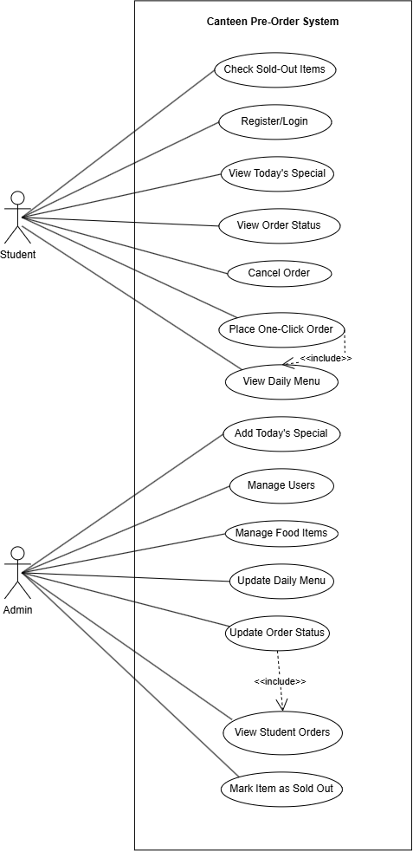
UML Diagrams
Use Case Diagram:

Slide 13
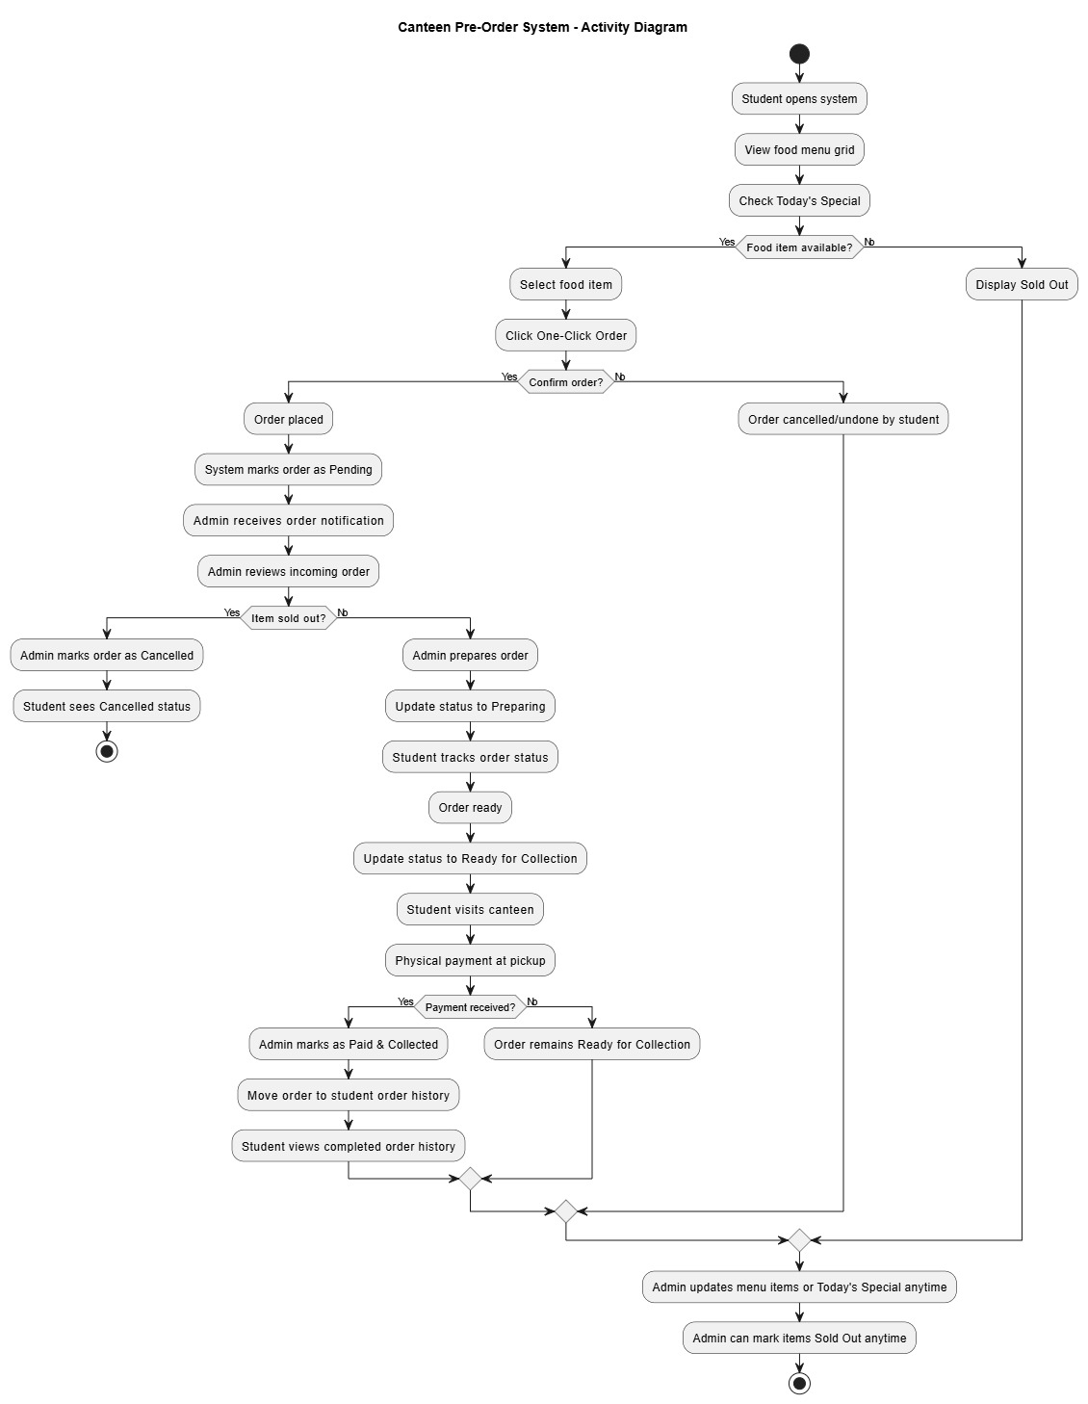
UML Diagrams
Activity Diagram:

Slide 14
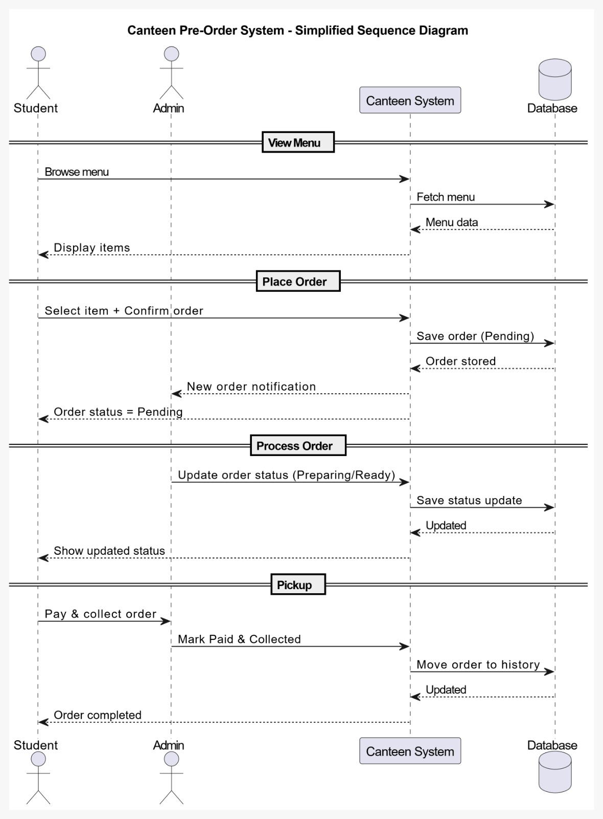
UML Diagrams
Sequence Diagram
Note: All of the actions mentioned requires logging in

Slide 15
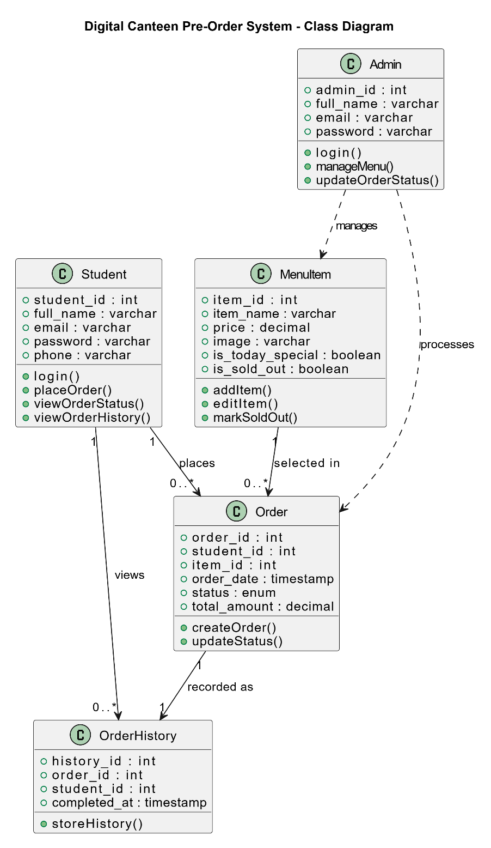
UML Diagrams
Class Diagram:

Slide 16
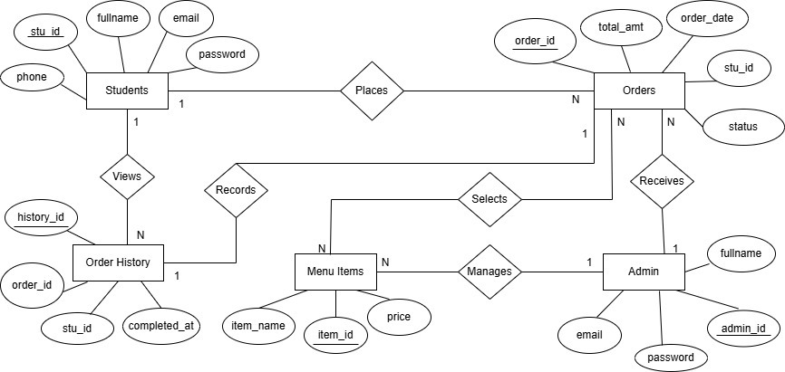
UML Diagrams
ER Diagram:

Slide 17
Timeline
Task Id | Task Name | Start Date | End Date | Duration(Days)
1 | Title Defense
1.1 | Topic Brainstorming | 26-Apr | 26-Apr | 1
1.2 | Topic Decision | 27-Apr | 27-Apr | 1
1.3 | Presentation Preparation and Division | 28-Apr | 29-Apr | 2
2 | Proposal Defense
2.1 | Literature Review and Figma Designing | 30-Apr | 02-May | 3
2.2 | UML Diagrams | 03-May | 06-May | 4
2.3 | Backlog | 07-May | 07-May | 1
2.4 | Preparation of Documentation and Presentation | 08-May | 09-May | 2
3 | Mid-Term Defense
3.1 | Correction of Diagrams and Project Work Division | 14-May | 15-May | 2
3.2 | Gantt chart | 18-May | 18-May | 1
3.3 | Project Implementation Start
3.3.1 | Database Definition and Login/Signup Page | 20-May | 22-May | 3
3.3.2 | User Dashboard and Admin Dashboard redirection | 23-May | 24-May | 2
3.3.3 | Order Menu creation(For users) and Admin custom menu for daily "Today's special" unique menu | 26-May | 28-May | 3
3.3.4 | Order POST Logic and display order on admin side | 28-May | 29-May | 2
3.4 | Testing and Test Case Creation | 30-May | 02-Jun | 4
3.5 | Documentation Correction | 03-Jun | 04-Jun | 2
3.6 | Documentation for Mid-Term Defense Creation | 05-Jun | 08-Jun | 4
3.7 | Presentation Preparation and Division | 12-Jun | 13-Jun | 2

Slide 18
Future Enhancements
• Mobile Application Integration Develop a mobile app to allow users to report issues instantly with push notifications and location-based services.
• Feedback and Rating System
Allow students to rate food and services
Help improve canteen quality

